Slide 1
Board Recognitions

Slide 2
Outgoing Board Member…
Trent Knoles (IL)

Slide 3
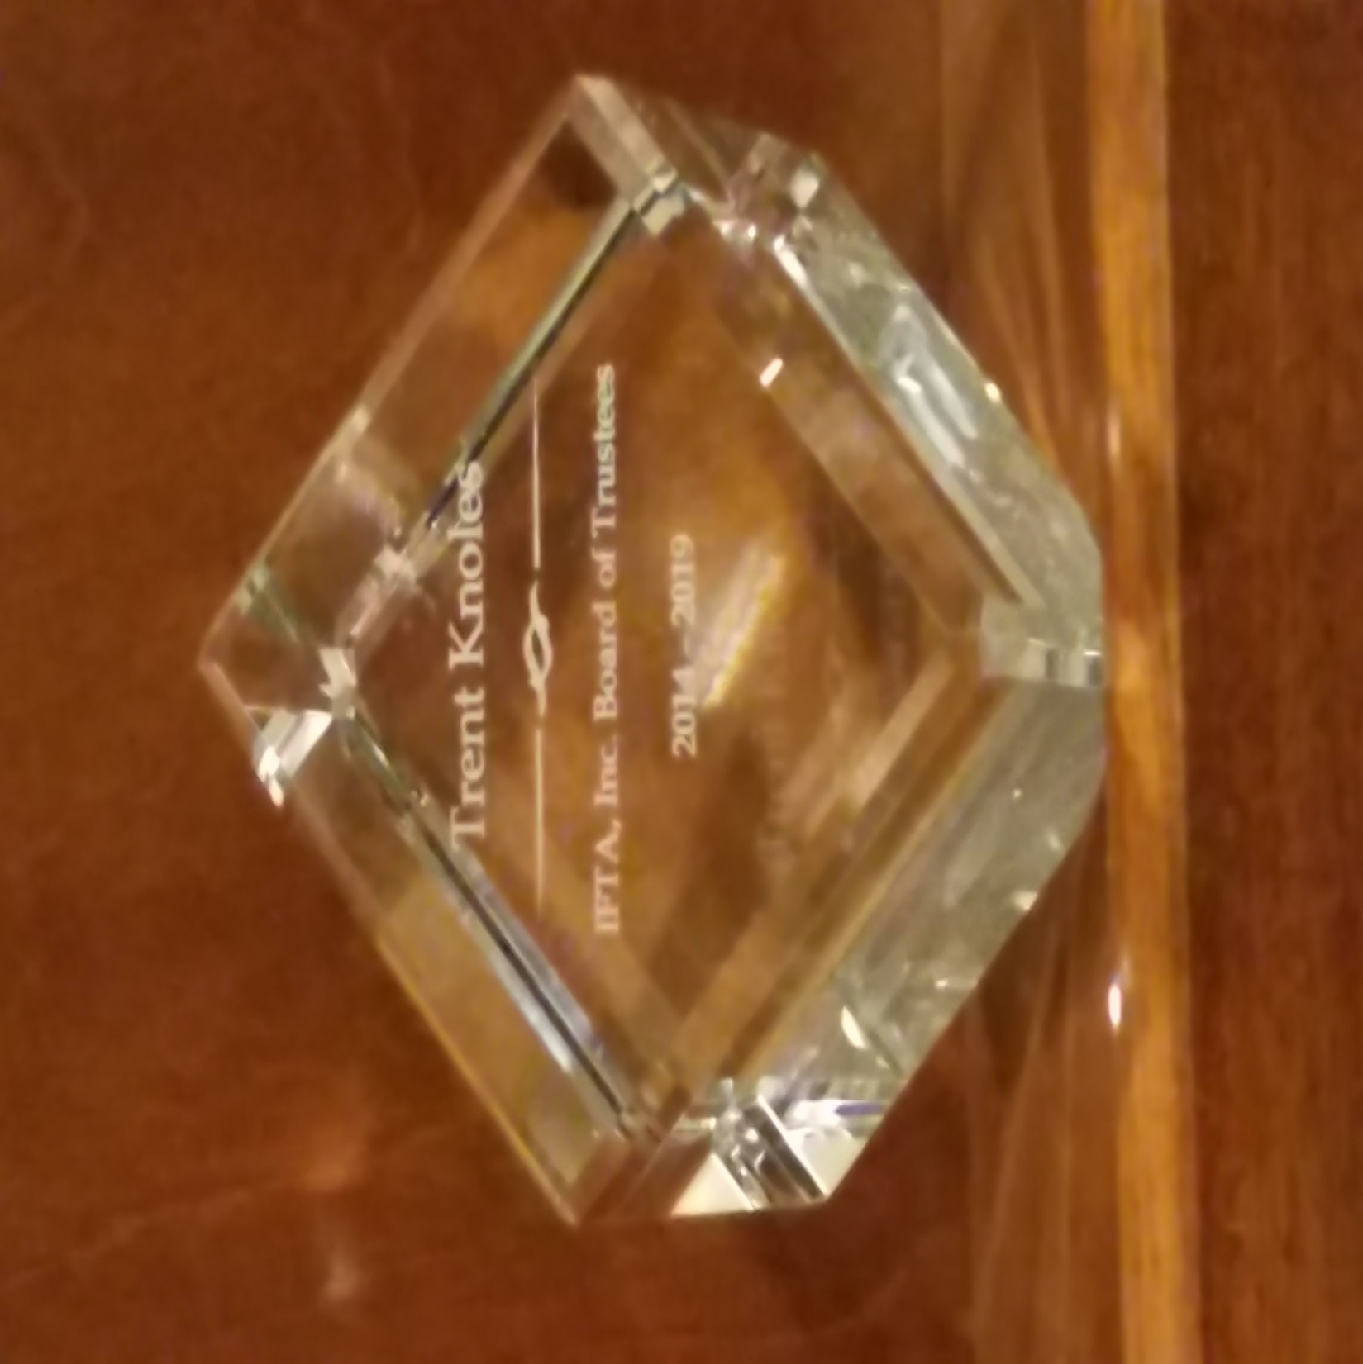

Slide 4
Outgoing Board Member…
Stephen Nutter (VA)

Slide 5
Board Recognitions
B

